Slide 1
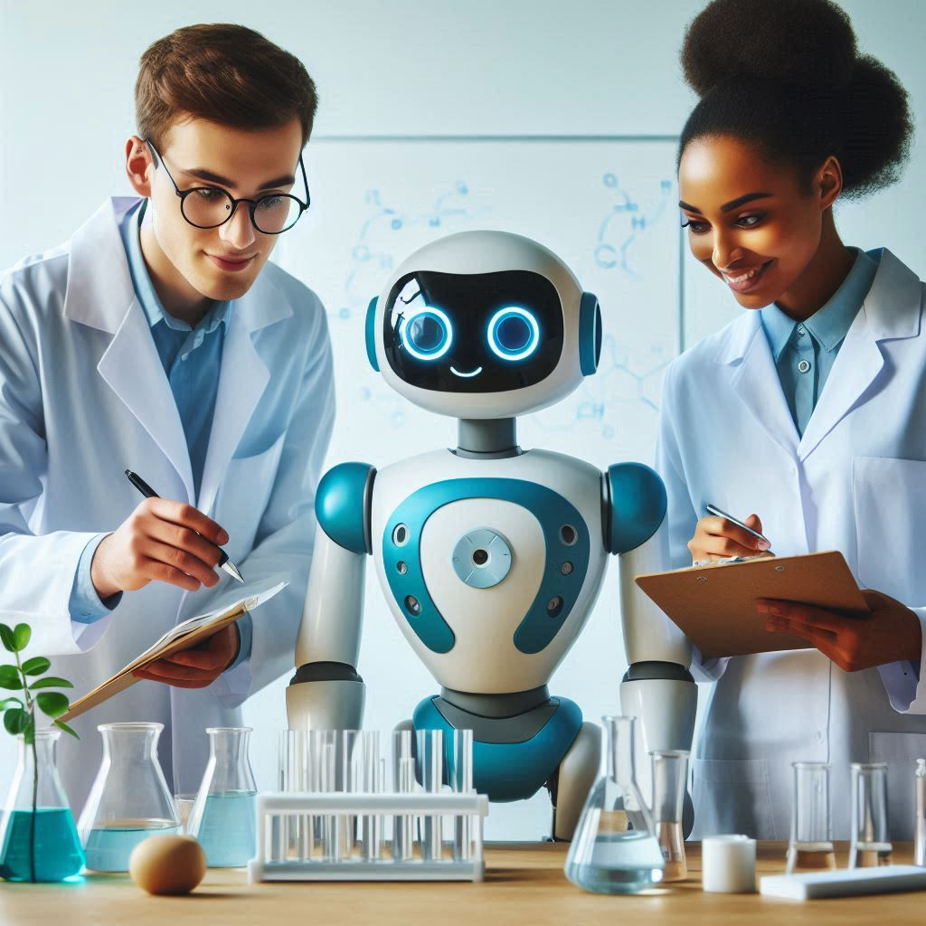

Generative AI for Researchers
Tools for researchers

Slide 2
Tools for researchers

Slide 3
Gen AI tools for researchers
heuristi.ca
perplexity AI
Explain Paper
Paperbrain
SCISPACE
Elicit
Quillbot
ideogram.ai
canva.com
claude.ai

Slide 4
Gen AI at academic research

Slide 5
Gen AI at academic research
Use AI to help you brainstorm
Use AI to gather and analyze data
Use AI to help verify your findings and enhance transparency
Use AI to predict and then parse reviewer feedback

Slide 6
FAQs

Slide 7
Best Practices
Always remember that AI is an enhancer, not a replacement
Verify results (always)
Stay informed about the developments in the field

Slide 8
Can I use generative AI to write and/or develop research papers?
Academic publishers have a range of policies on the use of AI in research papers.
In some cases, publishers may prohibit the use of AI for certain aspects of paper development. You should review the specific policies of the target publisher to determine what is permitted.

Slide 9
Sampling of Publisher’s policies available online
Elsevier https://www.elsevier.com/about/policies-and-standards/publishing-ethics#4-duties-of-authors
JAMA and the JAMA Network https://jamanetwork.com/journals/jama/fullarticle/2801170
PLOS ONE https://journals.plos.org/plosone/s/ethical-publishing-practice#loc-artificial-intelligence-tools-and-technologies
Sage https://us.sagepub.com/en-us/nam/chatgpt-and-generative-ai-0
Springer Nature https://www.nature.com/nature-portfolio/editorial-policies/ai#:~:text=As%20publishers%2C%20we%20strictly%20follow,permit%20its%20use%20for%20publication.
Science https://www.science.org/content/page/science-journals-editorial-policies
Wiley https://authorservices.wiley.com/ethics-guidelines/index.html

Slide 10
How should AI-generated content be cited in research papers?
Guidance will likely develop as AI systems evolve, but some leading style guides have offered recommendations:
APA Style
The Chicago Manual of Style
MLA Style Guide

Slide 11
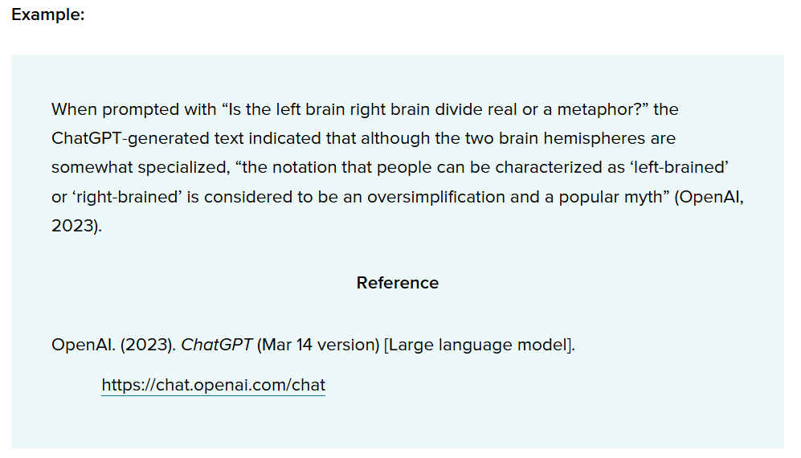
APA Citation example

Slide 12
APA style
Author: The author of the model is OpenAI.
Date: The date is the year of the version you used. Following the template in Section 10.10, you need to include only the year, not the exact date. The version number provides the specific date information a reader might need.
Title: The name of the model is “ChatGPT,” so that serves as the title and is italicized in your reference, as shown in the template. Although OpenAI labels unique iterations (i.e., ChatGPT-3, ChatGPT-4), they are using “ChatGPT” as the general name of the model, with updates identified with version numbers.
The version number is included after the title in parentheses. The format for the version number in ChatGPT references includes the date because that is how OpenAI is labeling the versions. Different large language models or software might use different version numbering; use the version number in the format the author or publisher provides, which may be a numbering system (e.g., Version 2.0) or other methods.

Slide 13
Should I disclose the use of generative AI in a research paper?
Yes. Most academic publishers require researchers using AI tools to document this use in the methods or acknowledgements sections of their papers.
You should review the specific guidelines of the target publisher to determine what is required.

Slide 14
Can I use AI in writing grant applications?
You should review the specific policies of potential funders to determine if the use of AI is permitted.
The National Institutes of Health (NIH) advises caution: “If you use an AI tool to help write your application, you also do so at your own risk,” as these tools may inadvertently introduce issues associated with research misconduct, such as plagiarism or fabrication.

Slide 15
Can I use AI in the peer review process?
Many funders have not yet published policies on the use of AI in the peer review process. However, the National Institutes of Health (NIH) has prohibited such use “for analyzing and formulating peer review critiques for grant applications and R&D contract proposals.” You should carefully review the specific policies of funders to determine their stance on the use of AI

Slide 16
Are there AI safety concerns or potential risks I should be aware of?
Yes. Some of the primary safety issues and risks include the following:
Bias and discrimination: The potential for AI systems to exhibit unfair or discriminatory behavior.
Misinformation, impersonation, and manipulation: The risk of AI systems disseminating false or misleading information, or being used to deceive or manipulate individuals.
Research and IP compliance: The necessity for AI systems to adhere to legal and ethical guidelines when utilizing proprietary information or conducting research.
Security vulnerabilities: The susceptibility of AI systems to hacking or unauthorized access.
Unpredictability: The difficulty in predicting the behavior or outcomes of AI systems.
Overreliance: The risk of relying excessively on AI systems without considering their limitations or potential errors.

Slide 17
Initial guidelines for the use of Generative AI tools
Protect confidential data
You should not enter data classified as confidential into publicly-available Generative AI tools
Review content before publication
AI-generated content can be inaccurate, misleading, or entirely fabricated (sometimes called “hallucinations”) or may contain copyrighted material. You are responsible for any content that you publish that includes AI-generated material.
Adhere to existing academic policy
Review your School’s student and faculty handbooks and policies.
We expect that Schools will be developing and updating their policies as we better understand the implications of using Generative AI tools.
In the meantime, faculty should be clear with students they’re teaching and advising about their policies on permitted uses, if any, of Generative AI in classes and on academic work.
Students are also encouraged to ask their instructors for clarification about these policies as needed.

Slide 18
Comparasion of AI tools
https://huit.harvard.edu/ai/tools

Slide 19


Q&A

